Slide 1
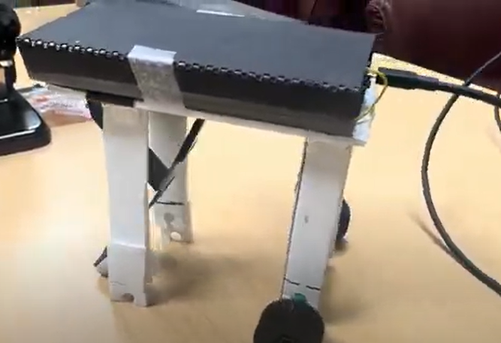
MonoPaw: A Single-Leg Canine Gait Robot
Team members: Tirth Kamdar, Vamshikrishna Gadde
Bioinspired Animal: Canis lupus familiaris
Proposed Mechanism: Single legged gait

Slide 2
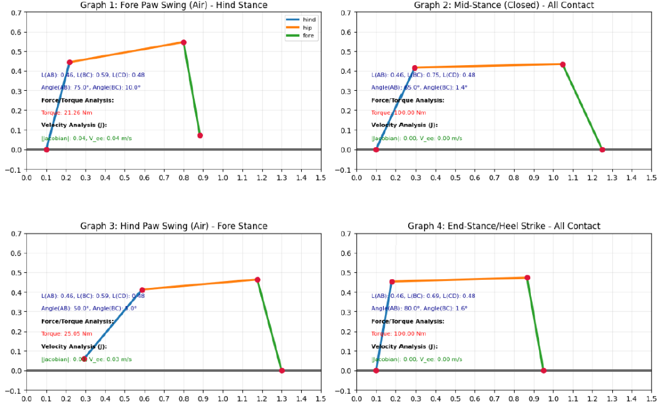
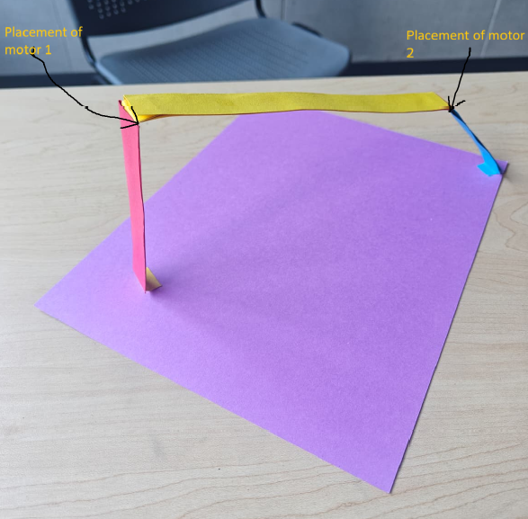
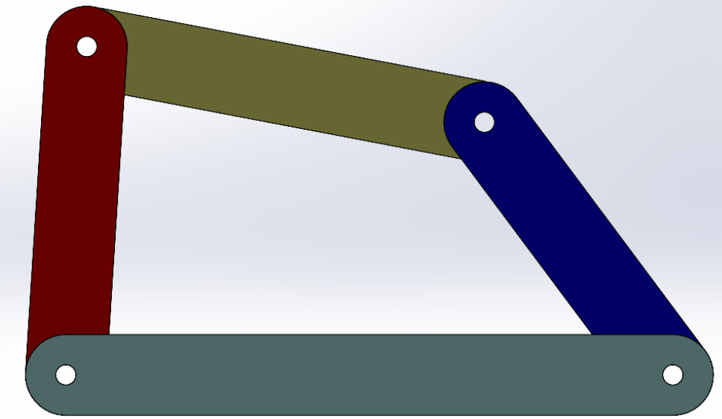
Project Assignment 1(old)
Objective: Vary trunk length, paw spacing, or leg lengths and compute how foot velocity capability changes — find robust ranges.
Scope: We have decided to implement a few constraints in this project like in this project we are just going to use a hind limb, a fore limb, hip and ground to make it a 4 bar closed mechanism and change parameters like length of the limb or distance between the limbs to find out changes in velocity.
Why we decided to change it: For this project, we were trying to solve the kinematics for 2 diagonal canine legs which move in same phase but it is difficult to implement the forces, torque and other parameters for 2 legs when we dont know how does that apply for even a single leg so because of that we decided to change the scope of the project from hind and fore leg to a single leg and support mechanism

Slide 3

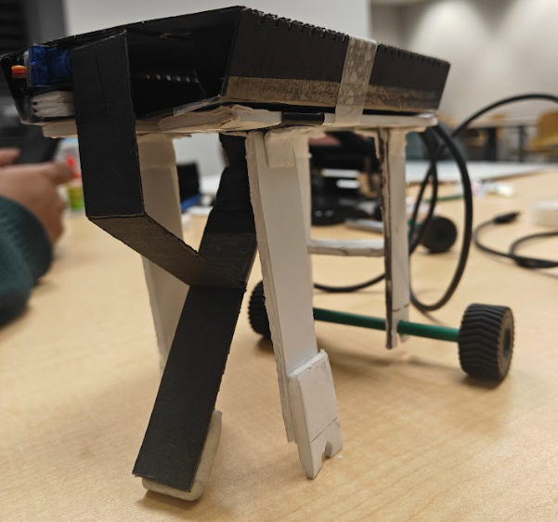
Project Assignment 1(new)
Objective: To investigate how link length and inter‑joint phase offset affect the locomotion performance of a simulated 5‑bar leg with cart support, by quantifying maximum end‑effector (foot) velocity and mechanical energy profiles for different design configurations.
Scope: This project focuses on a single 5‑bar leg attached to a cart‑like support, modeled as a planar mechanism driven by DC‑motor‑based joint actuators. We systematically vary link lengths and phase offsets between the two active joints while keeping all other parameters fixed, and evaluate the resulting foot kinematics and system energy.

Slide 4
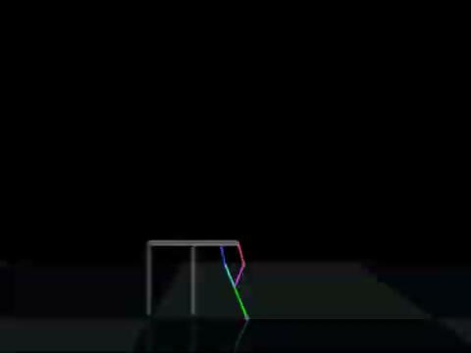
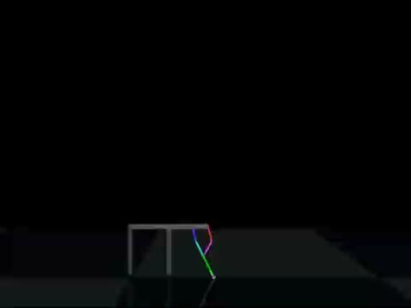
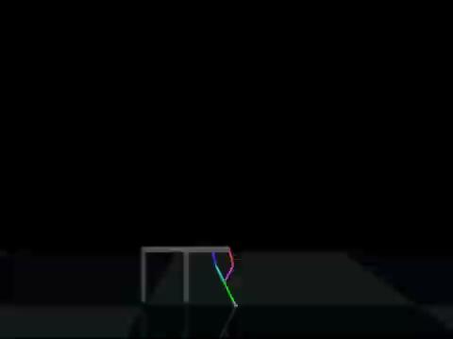
Mujoco Modeling
End effector released from the grounded state
Link length change to determine speed and energy
Phase offset change to determine change in velocity
Driven by a simple DC motor model (voltage, back‑EMF, gear ratio, stall torque)

Slide 5
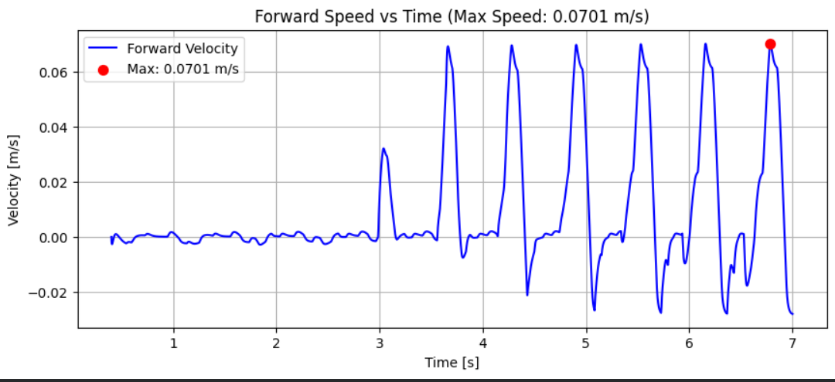
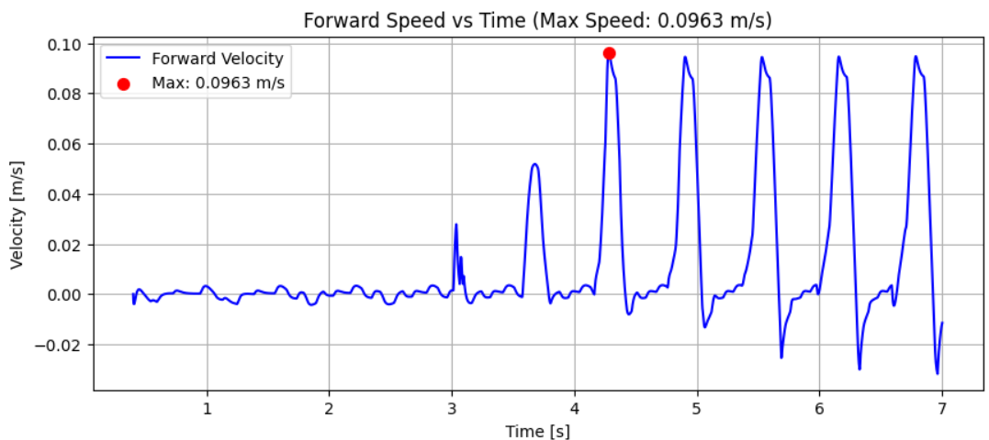
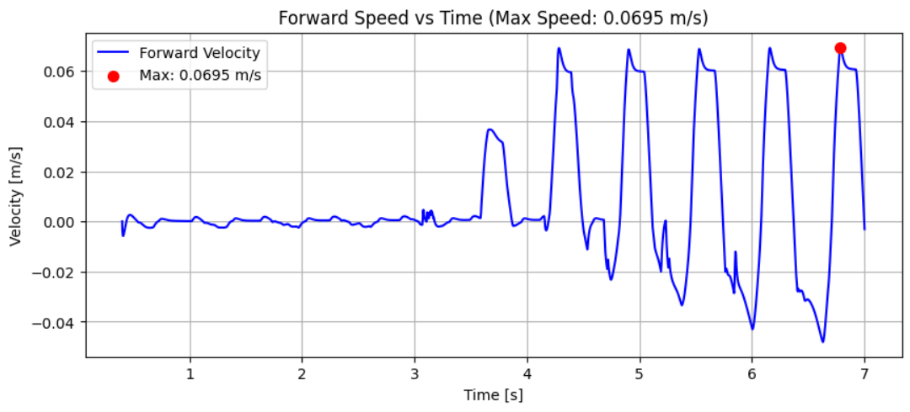
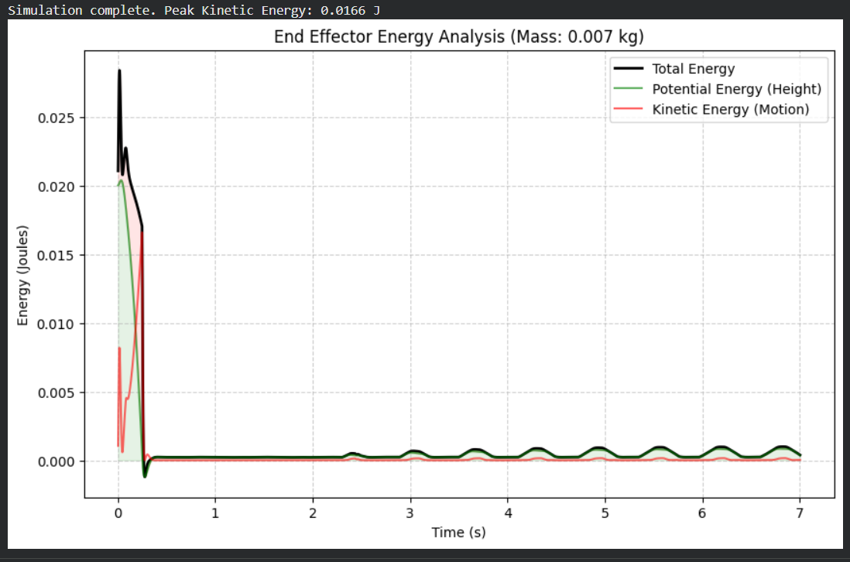
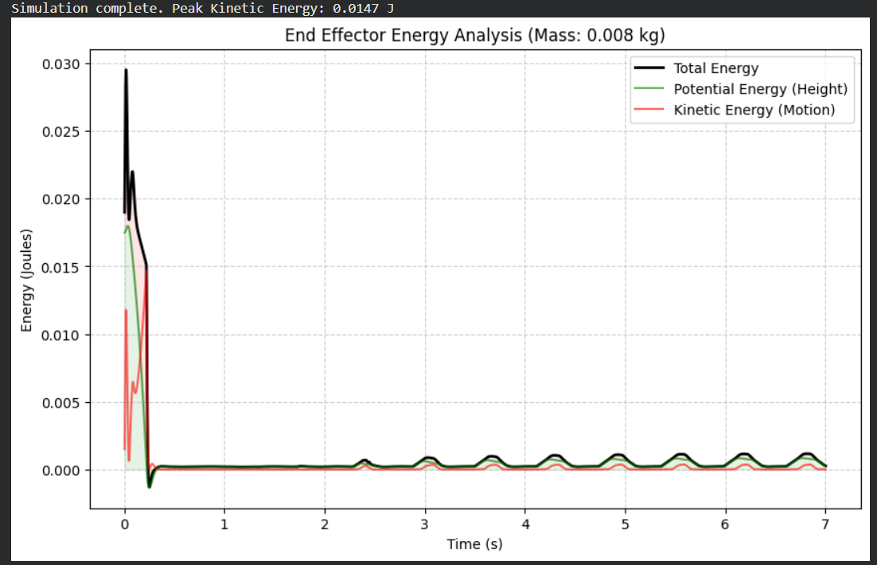
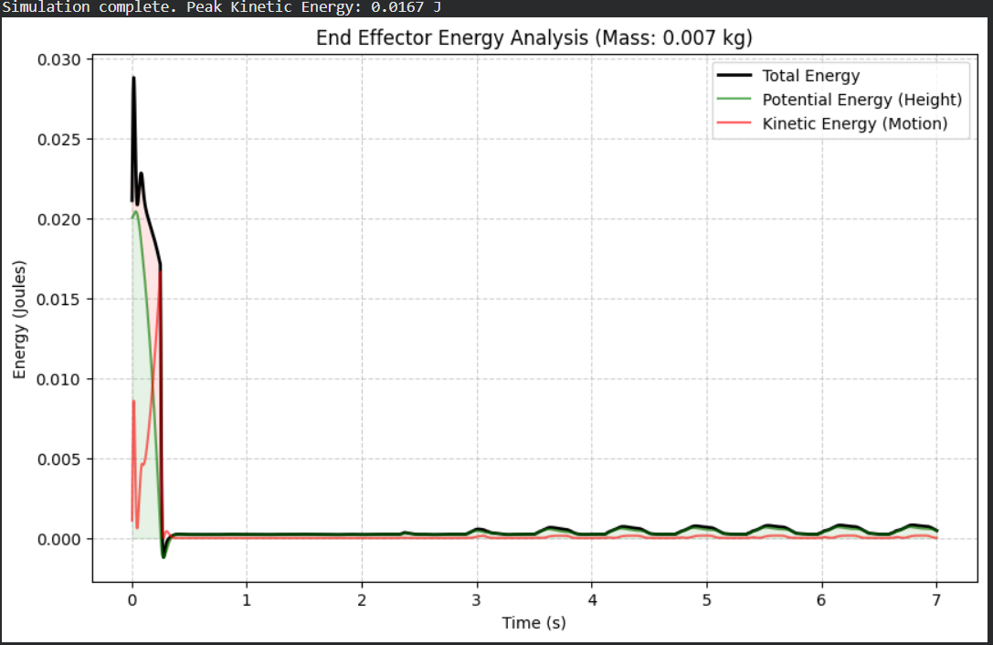
Design Optimization
Effect of Changed variable on parameters discovered:
3 cases compared: phase change of 𝜋/2 with fixed length, phase change of 𝜋/2 with scaled length (all links scaled 1.25x), phase change of 𝜋/4 with fixed length
First case is well balanced as it has good velocity for average energy consumed
Second case is best case scenario as it has most velocity for least energy required
3rd case is the worst case as it is least velocity covered and it required most energy when compared to the other 2
Optimal case:
In case of length: x1.25 scaled (preferably as long as possible)
In case of phase change: 𝜋/2

Slide 6
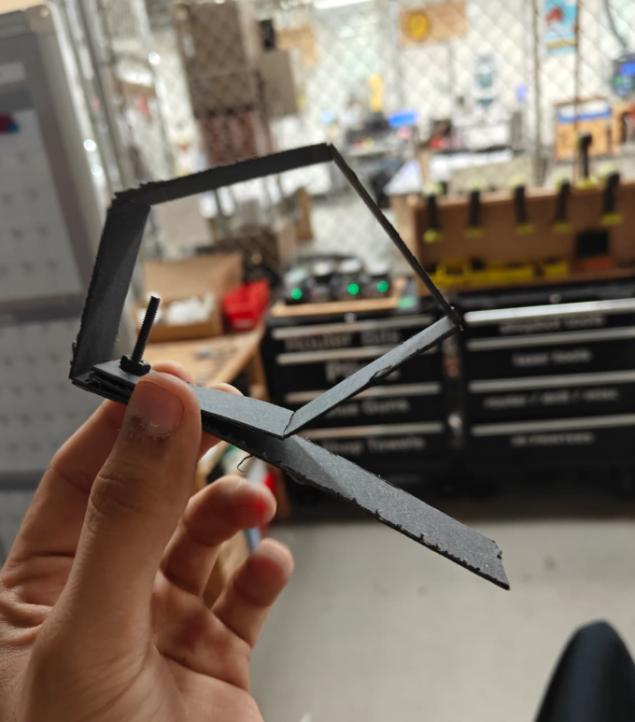
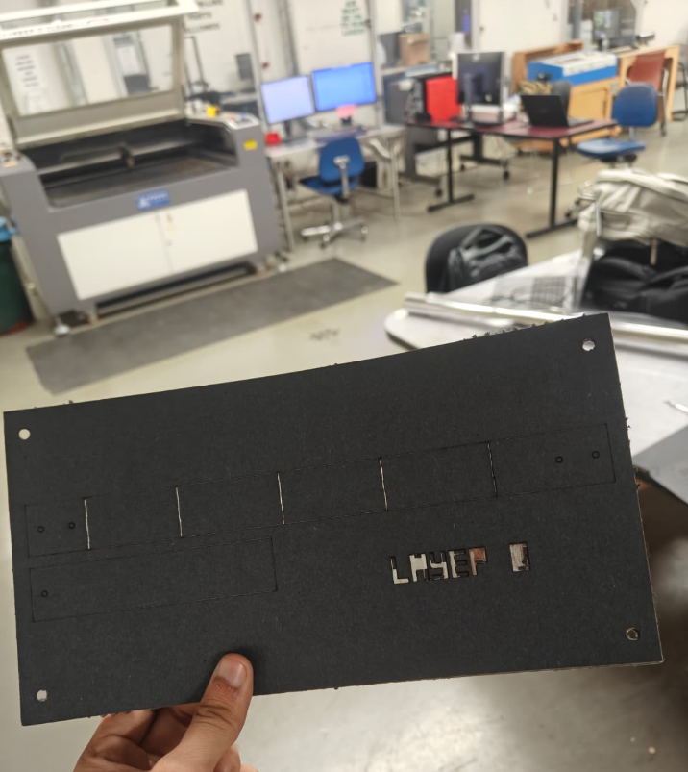
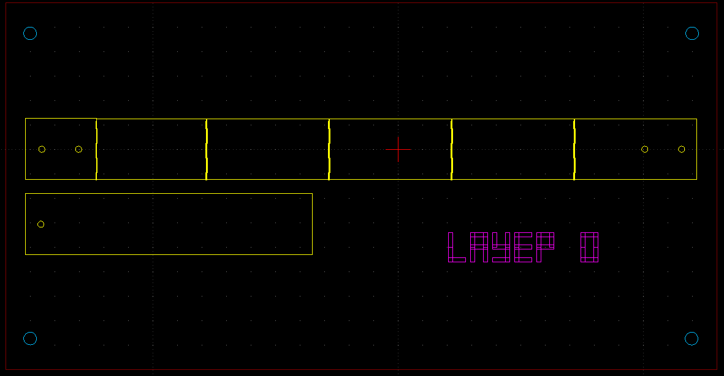
Manufacturing Workflow For Leg
5 Layer cut composition:
1st and 5th layer are matboard layer for providing strength
2nd and 4th layer are heat activated adhesive layers
3rd layer is polyester flexure layer
Laser used for cutting is a 30W CO2 laser

Slide 7
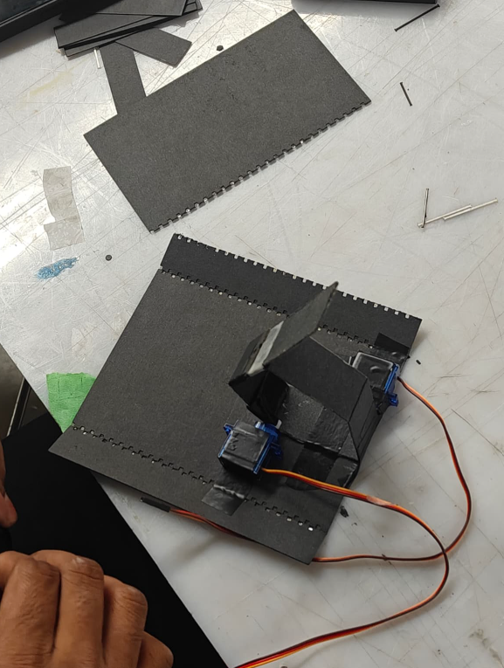
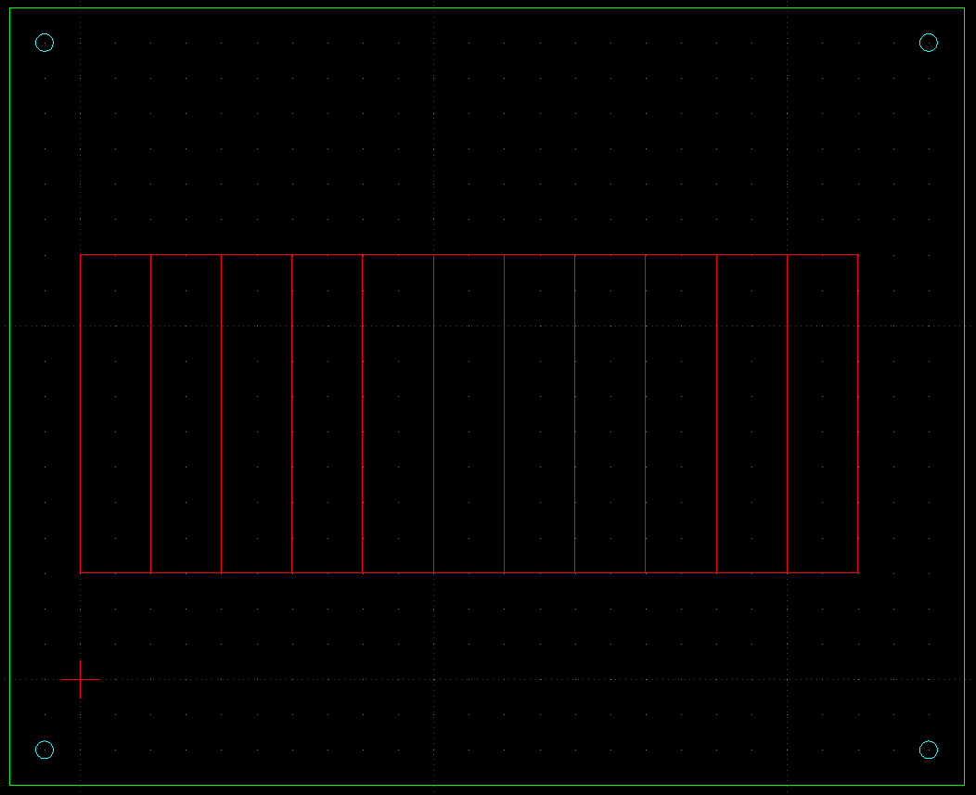
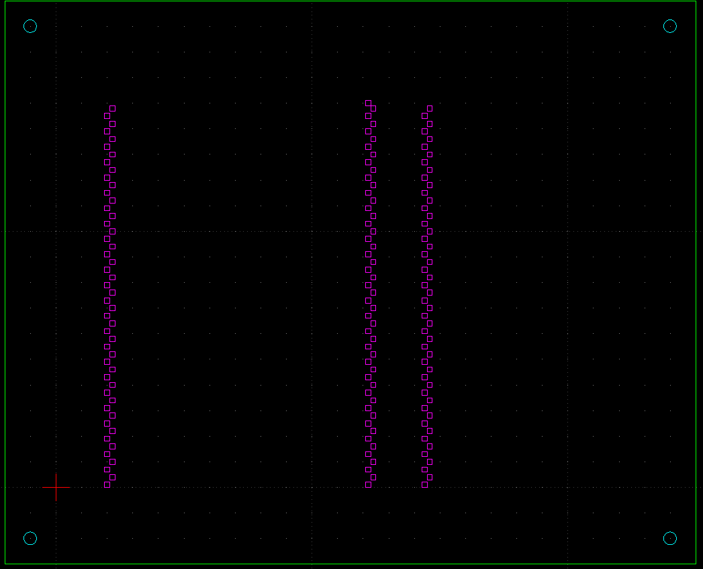
Manufacturing Workflow For Cart
Same 5 layer structure was used for the housing of the esp32, motors and the gait mechanism
The support structure to insert wheels were manufactured by single layer of matboard to decrease the overall weight so it can be lifted and push ahead by the leg mechanism

Slide 8
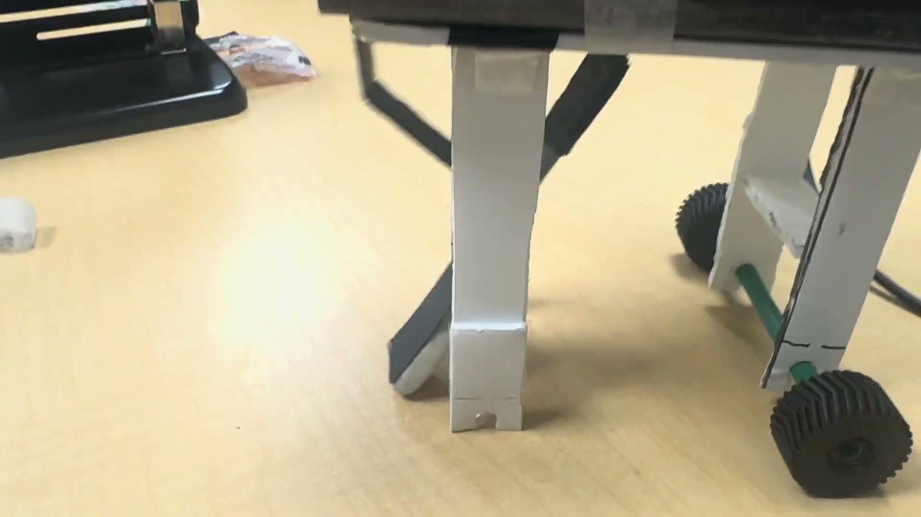
Final Prototype

Slide 9
Conclusion
MonoPaw demonstrates that a single-leg, canine-inspired robot can capture essential quadruped gait dynamics using simple, low-cost hardware and foldable construction.
Foldable-robotics techniques significantly reduce cost, build time, and re-design effort, making rapid iteration on leg geometry, stiffness and actuation layout practical for students and researchers.
The project establishes a clear pipeline from biological observation → kinematic abstraction → foldable mechanism → hardware validation, which can be reused for other bio-inspired systems.
Experimental results show that the mechanism can produce repeatable stance–swing cycles and highlight the importance of joint placement, mass distribution and control timing for stable motion.
As a teaching and outreach platform, MonoPaw provides an accessible, visually intuitive example of how animal locomotion translates into real robots, suitable for labs, demos and STEM education.

